Slide 1
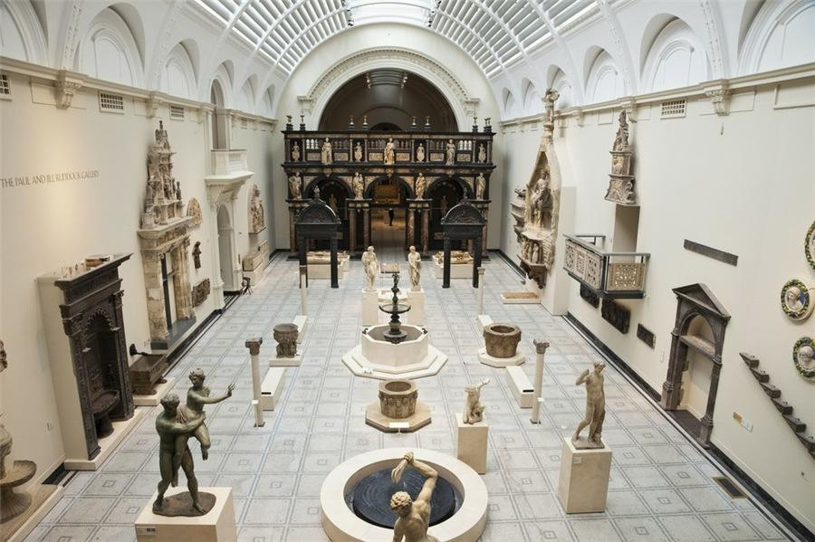
Museums Management Systems
Group 10 Member:
Aakash Patil
Amar Sai Kiran Poosarla
Danlin Lu
Minal Makwana
Siddhartha Savant

Slide 2
Outline
Objectives and Design
Final ERD
Implementation
Views and Data Visualization
DDL and Check Constraints
Insertion
Stored Procedure
UDF
Trigger
Encryption

Slide 3
Objectives and Design
Design
5 cardinal functions of the museums i.e., Donations, Reservations, Employment, Merchandise Selling and Merchandise Supplies
Objectives
For advertising purpose, museums need to record reservations from visitors and their reservations.
To receive more precious exhibits and get more influential, museums need to record donors and their donations.
To give staff better management, museums need to record employment contracts of all their staff.
To make more profits, museums need to sell related merchandise to people.
Merchandise management is important. Museums need to record information of merchandise and their inventory and suppliers.

Slide 4
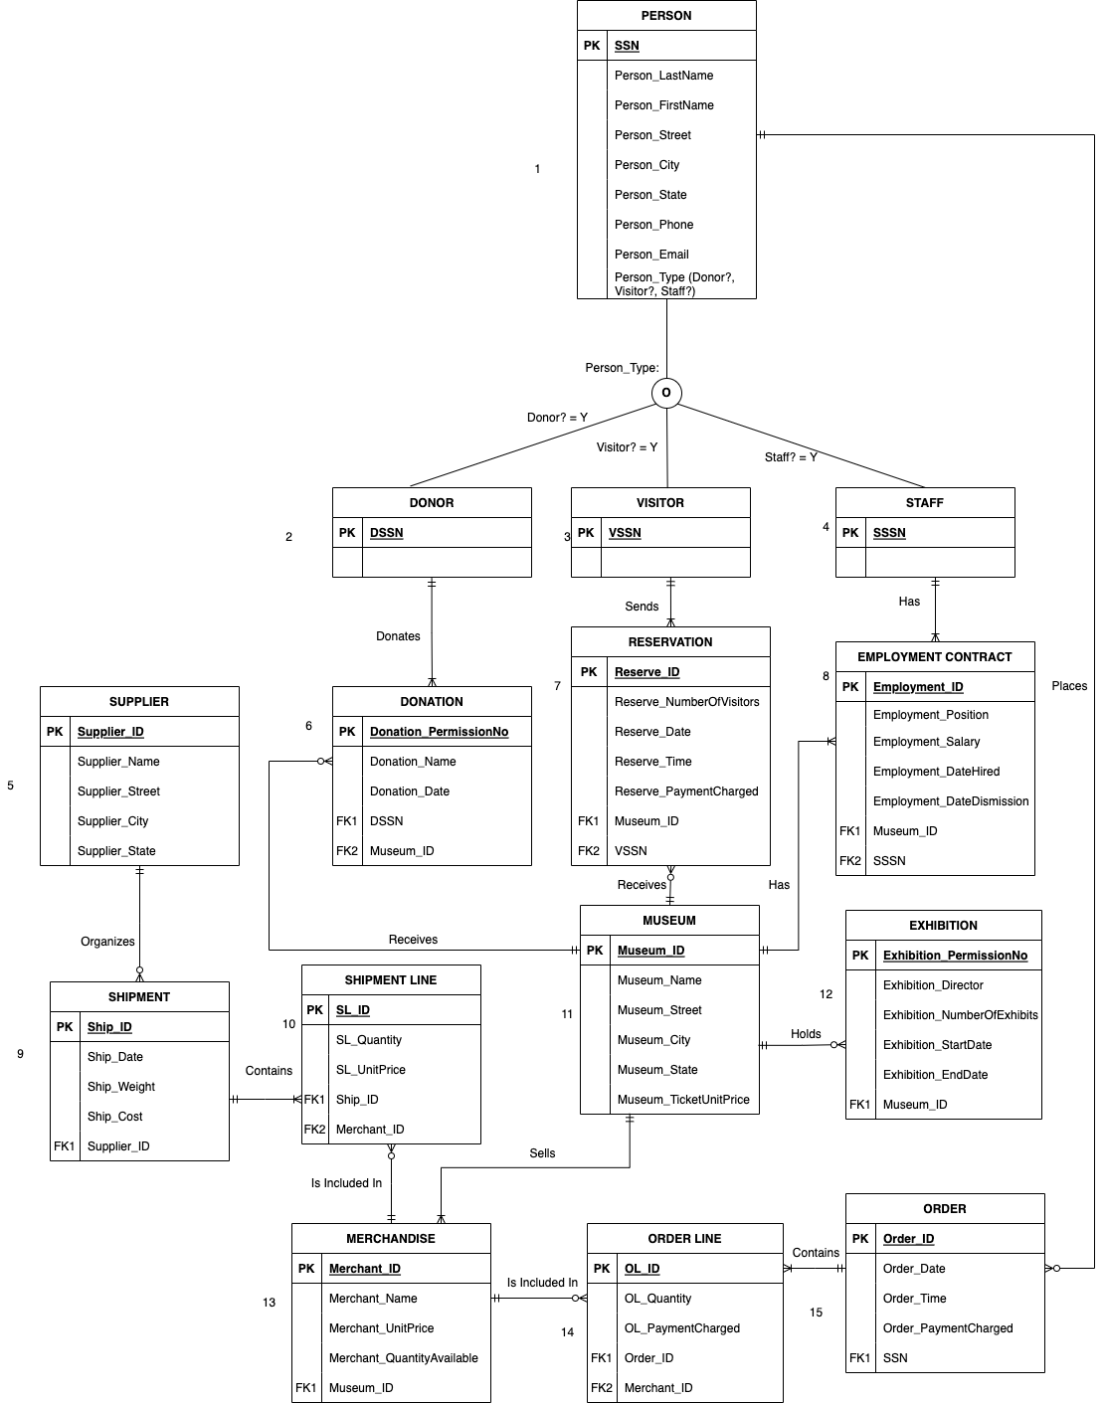
Final ERD

Slide 5
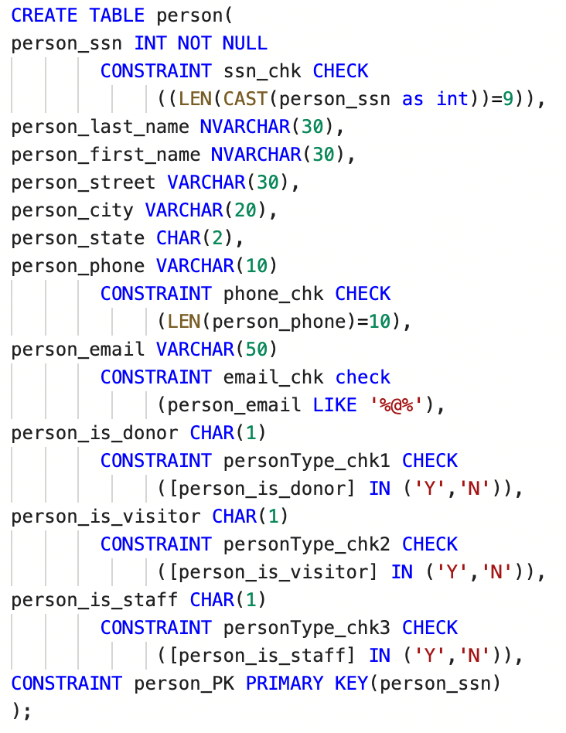
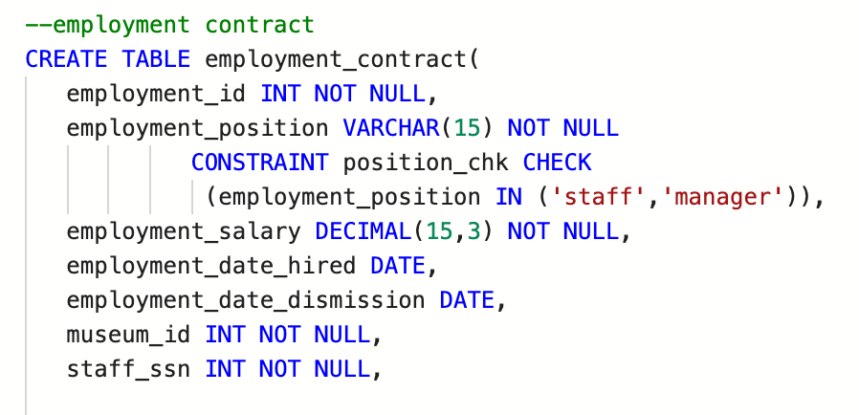


Implementation-DDL and Check Constraints

Slide 6
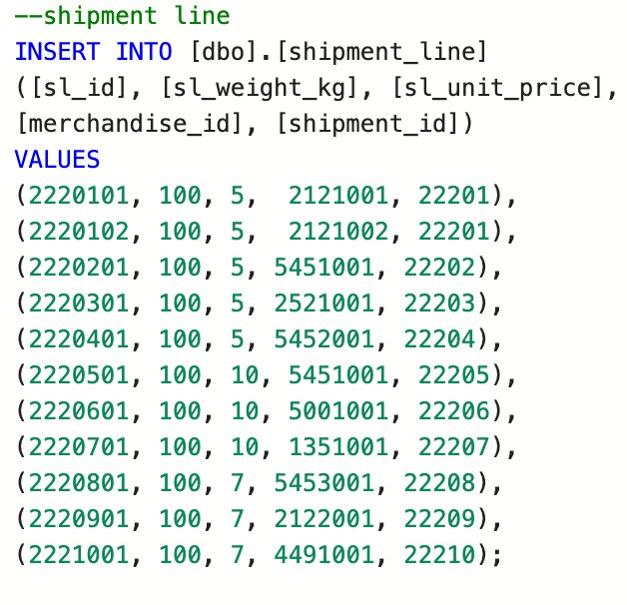
Implementation-Insertion
Table | Data
Person | 10 Donor, Visitor and Staff; 1 regular person
Donor | 10: 1 donated twice
Visitor | 10: 1 has 2 reservations
Staff | 10: 1 has 2 contracts
Donation | 11: 1 museum has no donation
Reservation | 11: 1 museum has no reservation
Employment Contract | 11: every museum has staff
Museum | 10
Exhibition | 10: 1 museum has no exhibition
Merchandise | 11: 1 museum has 2 merchandise
Order | 10: only 4 people order
Order Line | 11: 1 order with 2 lines
Supplier | 10: only 3 have shipments
Shipment | 10: 1 with 2 lines
Shipment Line | 11: ship 10 merchandise where 1 in 2 lines
Sample Insertion

Slide 7
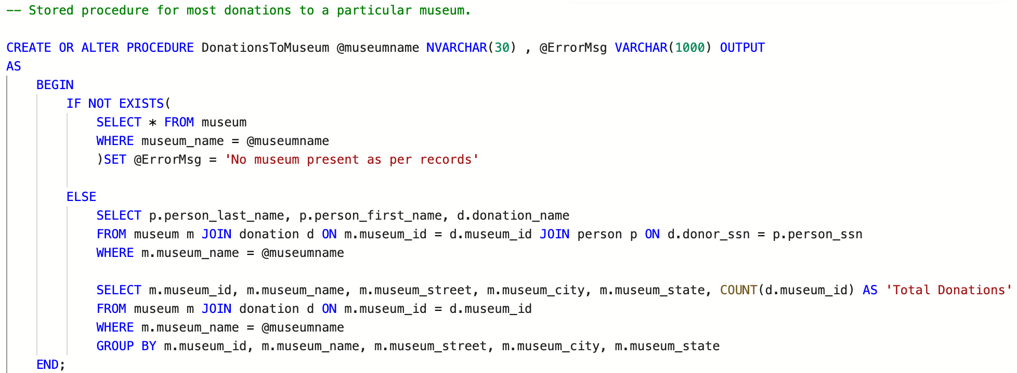
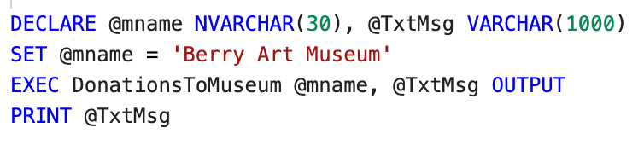
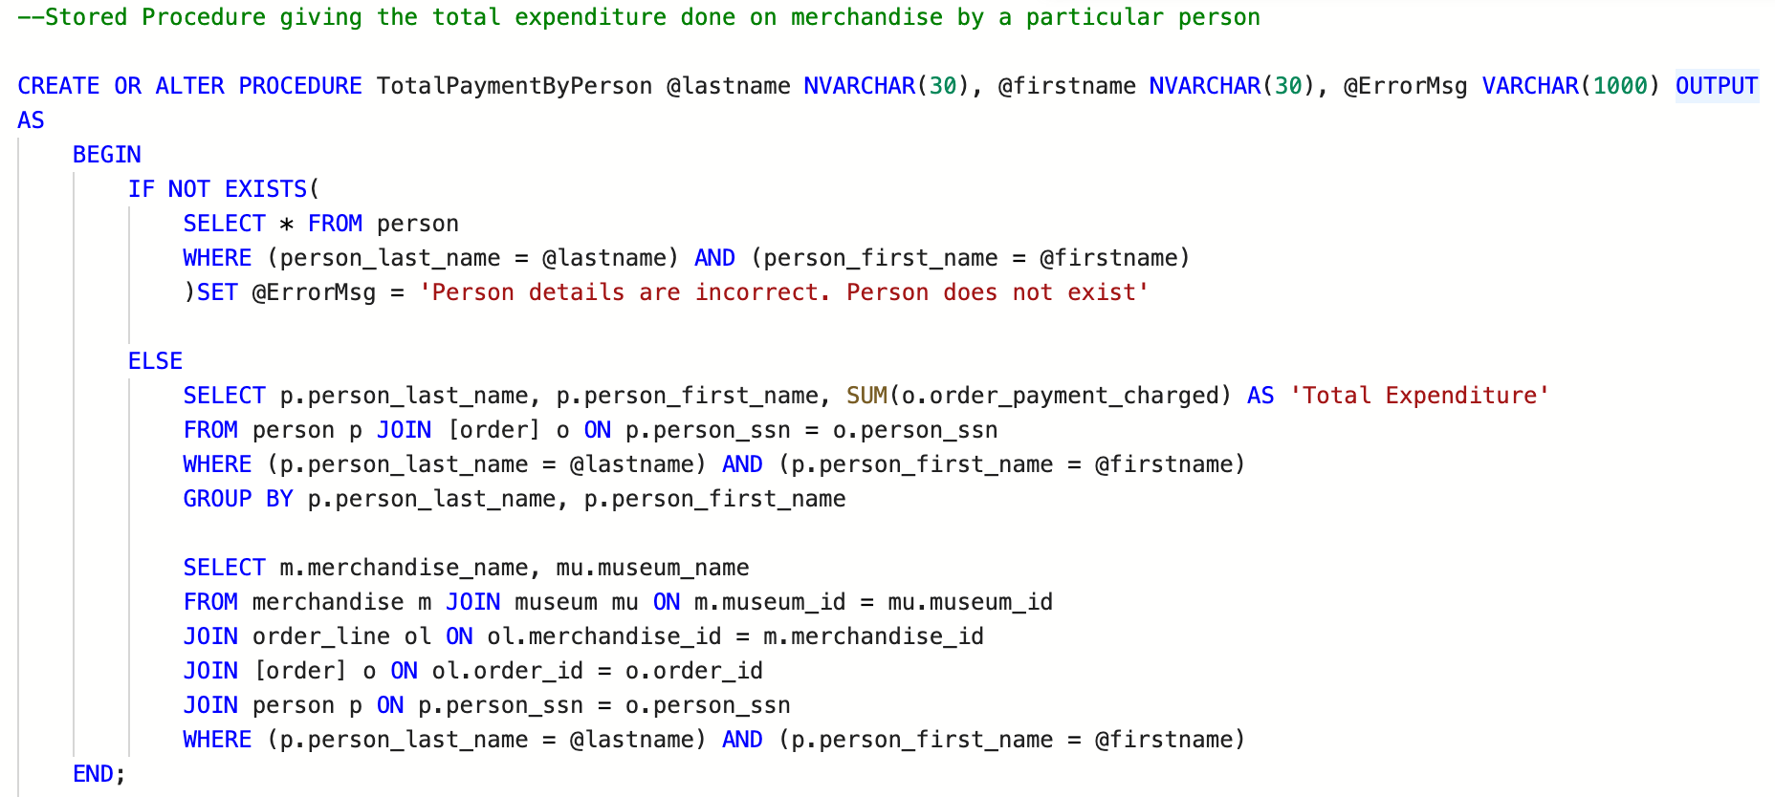
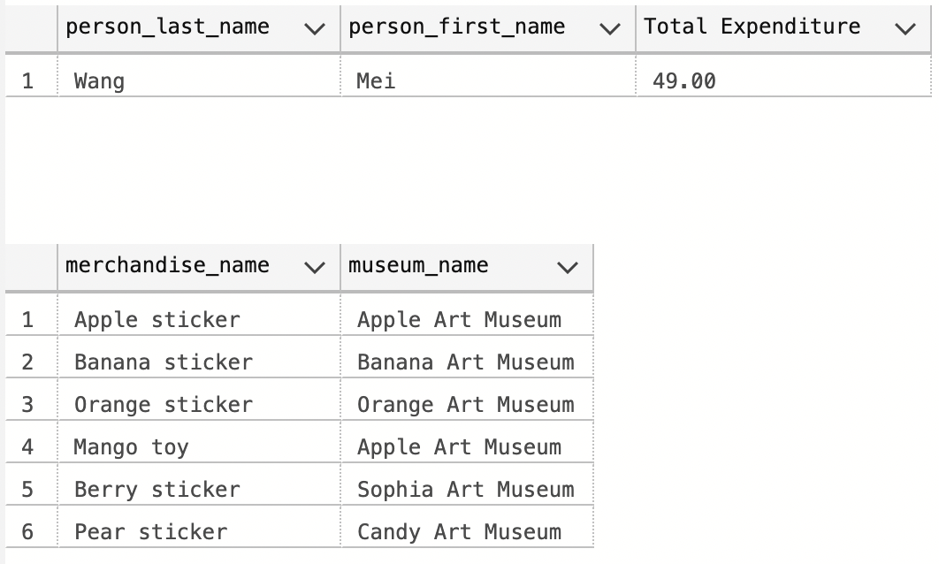
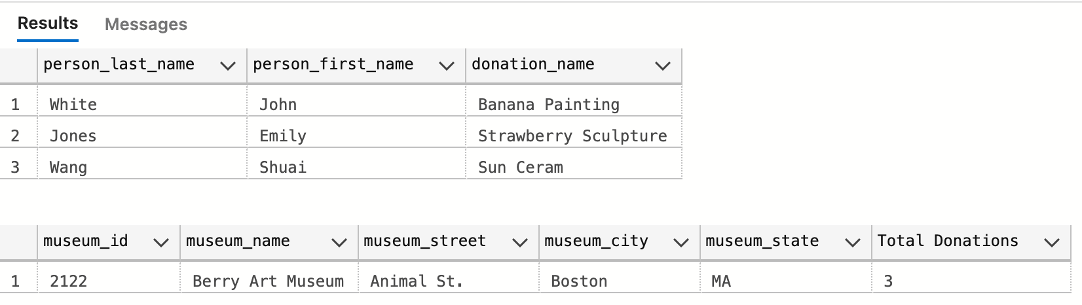
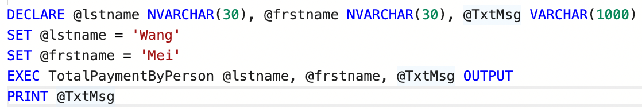
Implementation-Stored Procedures
Our procedures are related to objectives.
2nd: show the total donations a particular museum has received, helping analyze the influence of the museum.
1st: show the total expenditure done by a particular customer, helping analyze customer behavior

Slide 8
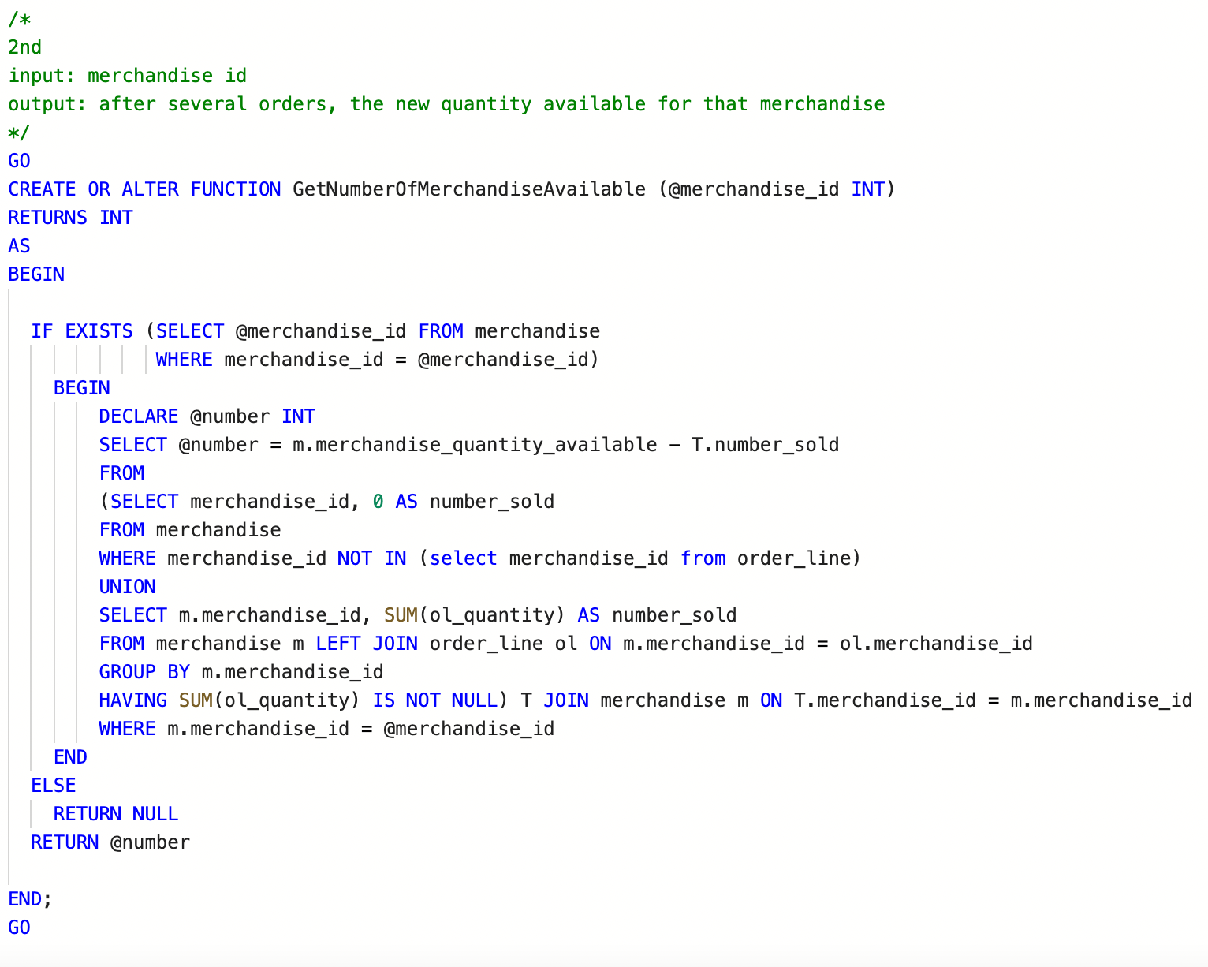
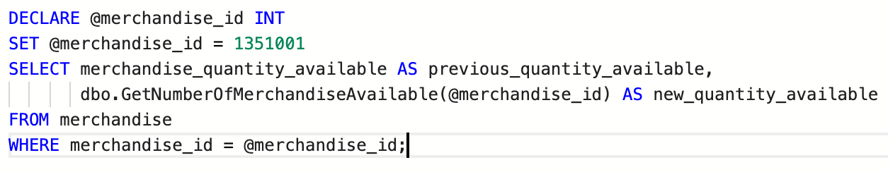
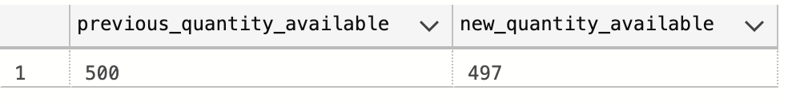
Implementation-UDF
This UDF gets the current inventory of the merchandise, helping museums to decide when to call suppliers to supply merchandise

Slide 9
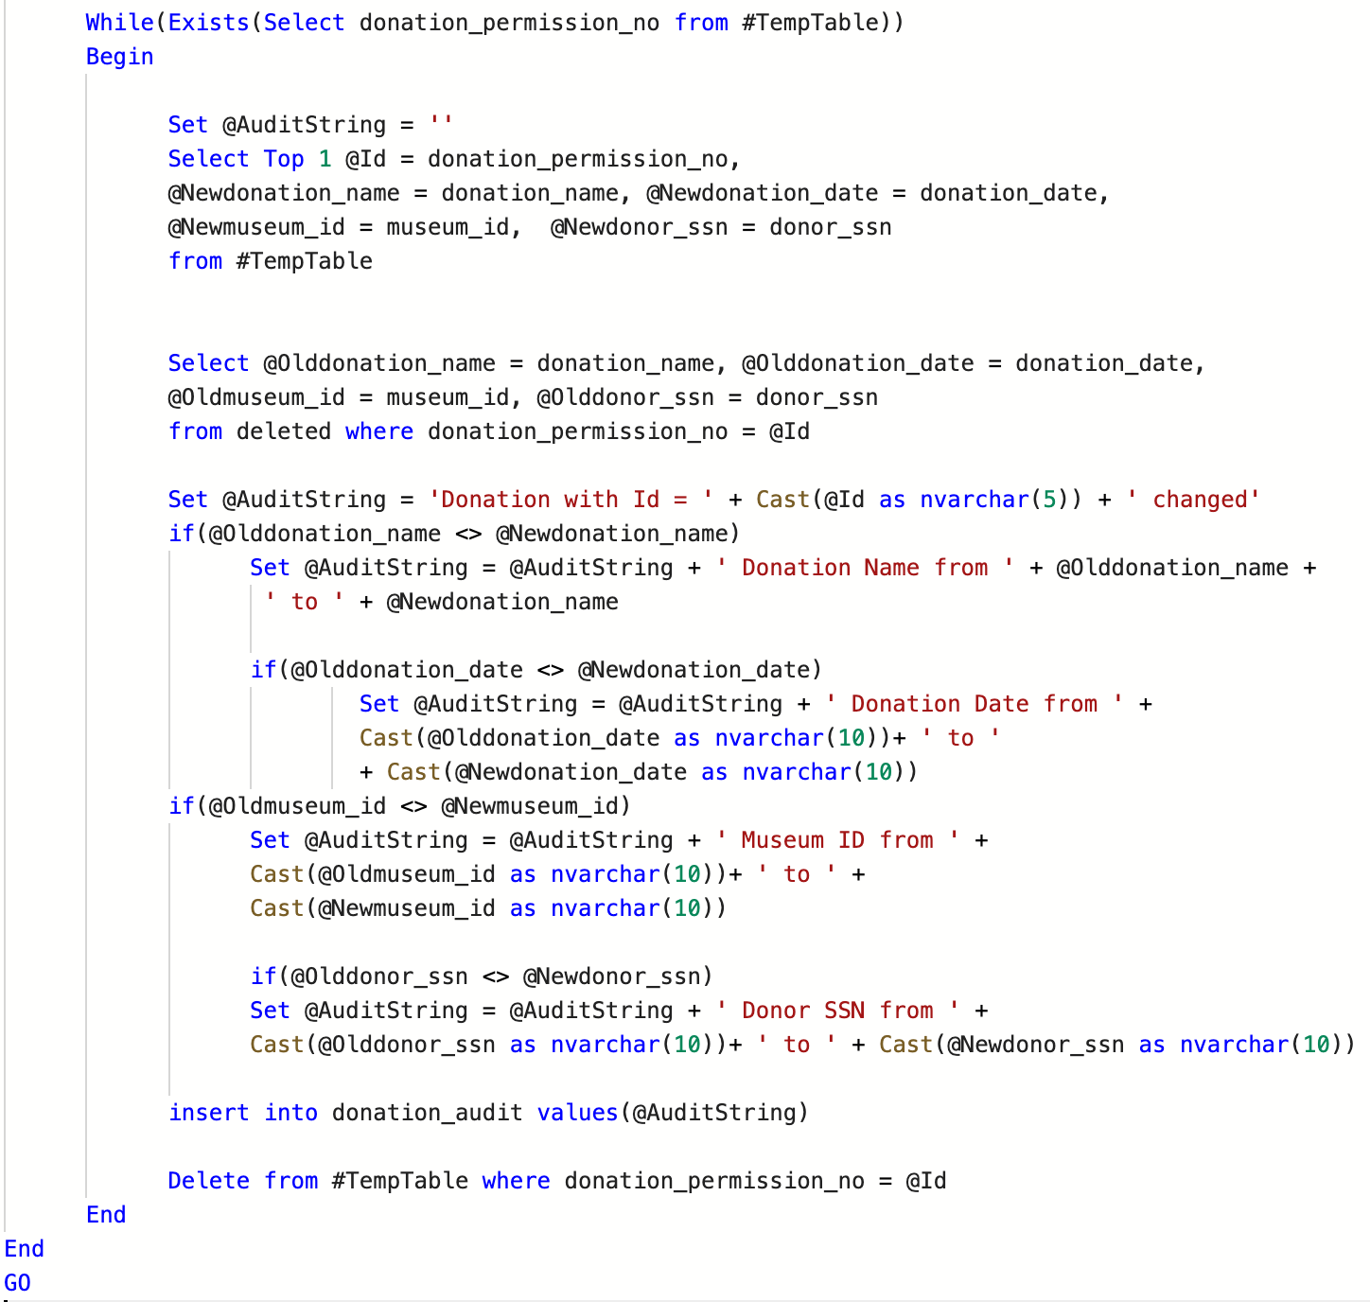
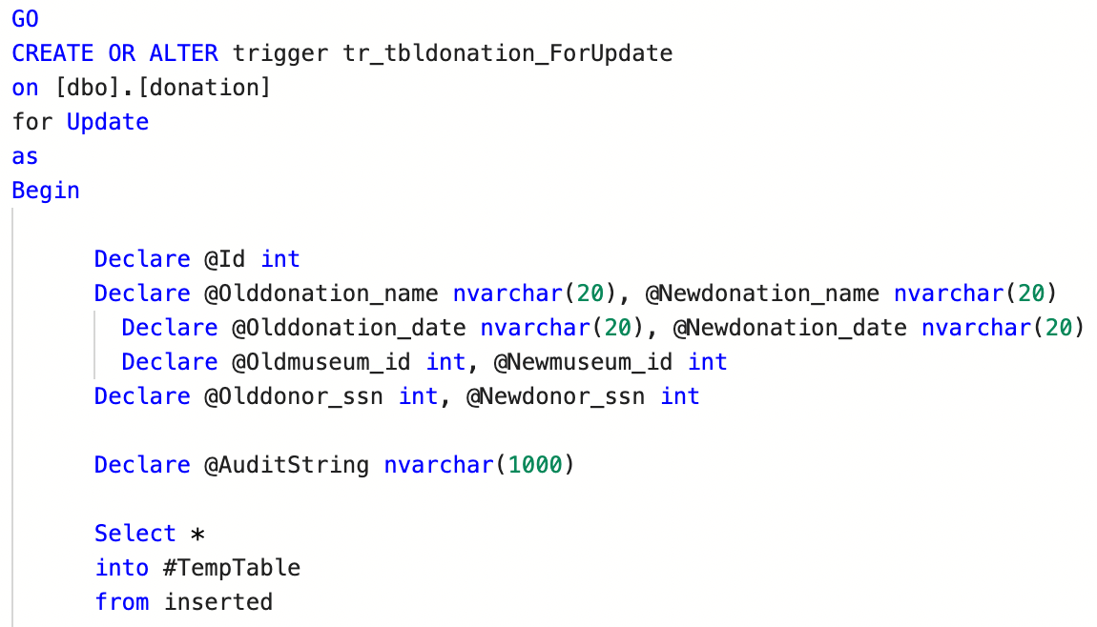
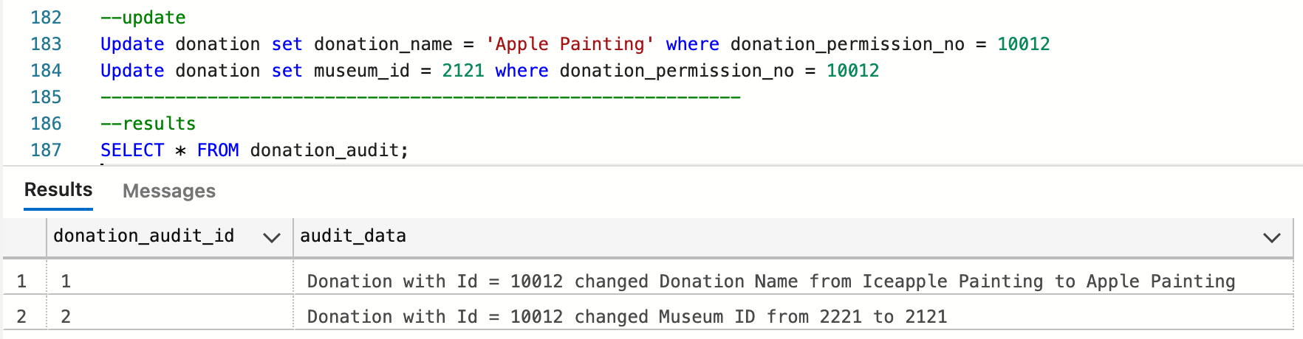
Implementation-Triggers
Traditional trigger: record the changes of one attribute of a particular entity
Our trigger: record the changes of all attributes of a particular entity

Slide 10
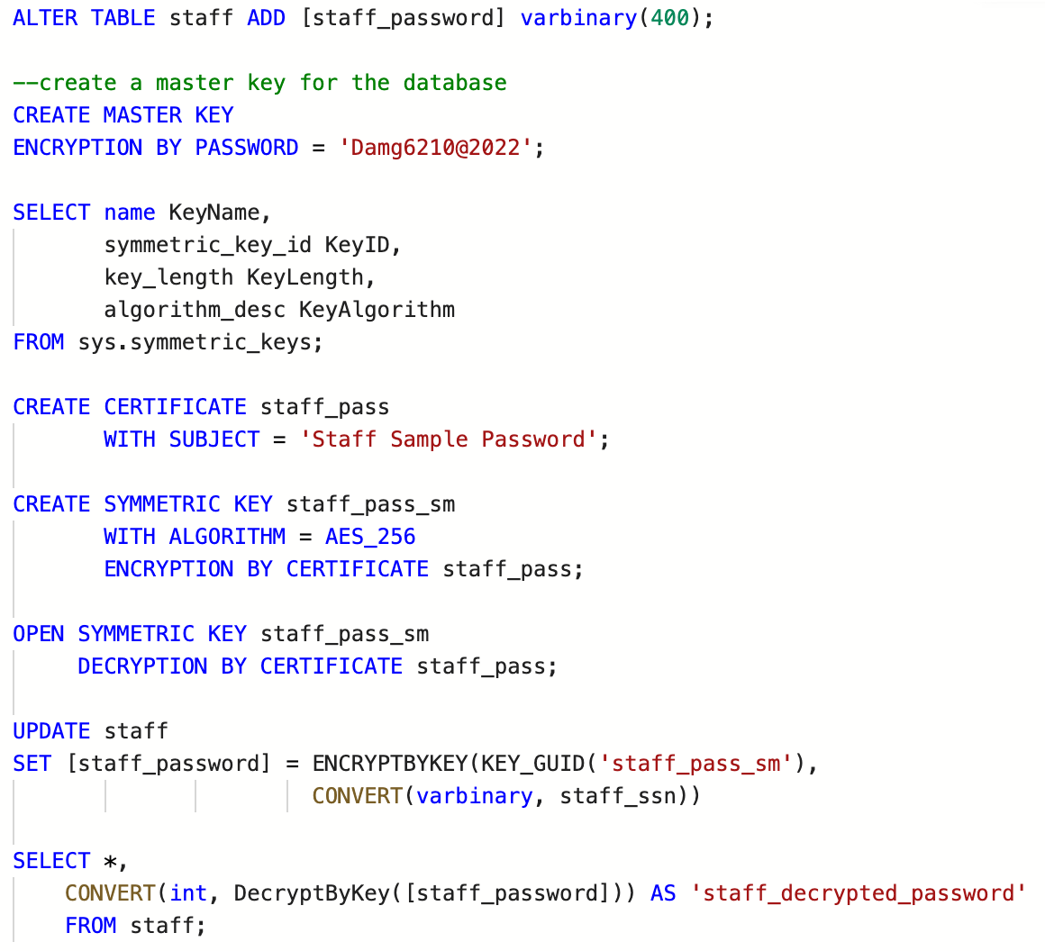
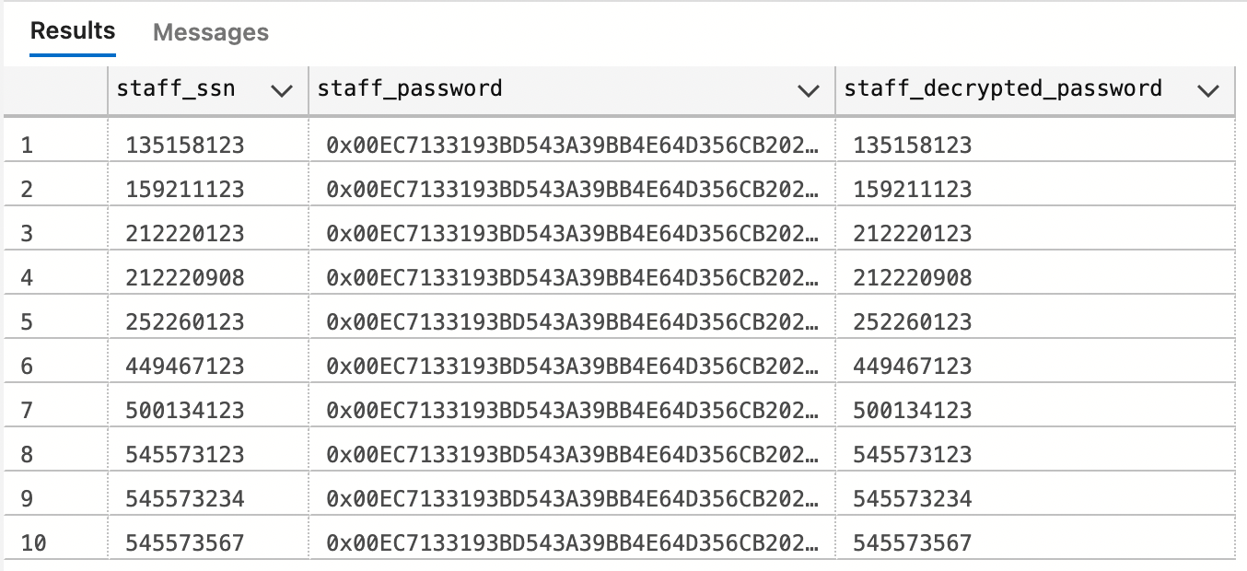
Implementation-Encryption
Encryption is to protect business secrets of museums

Slide 11
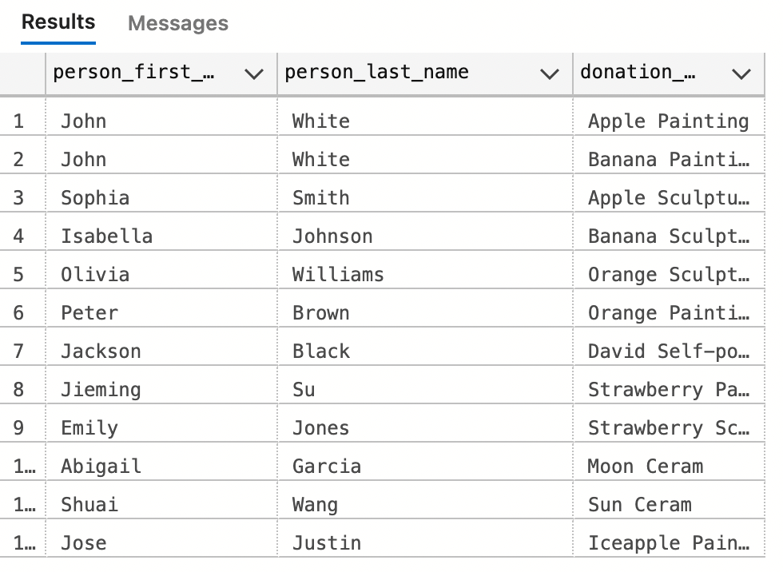
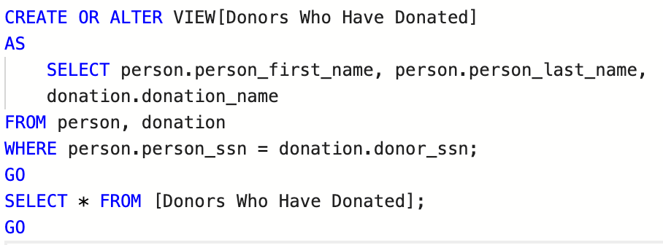
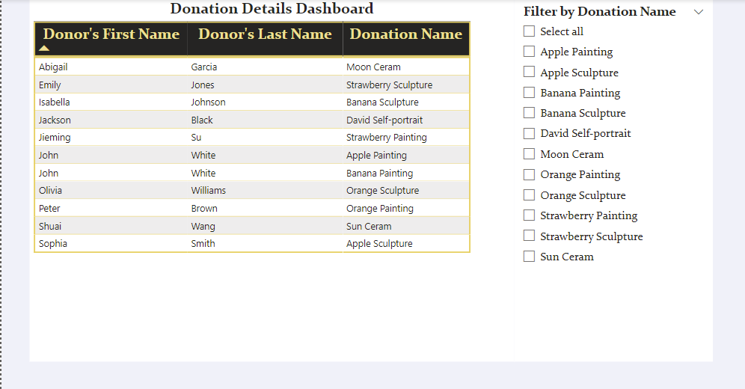
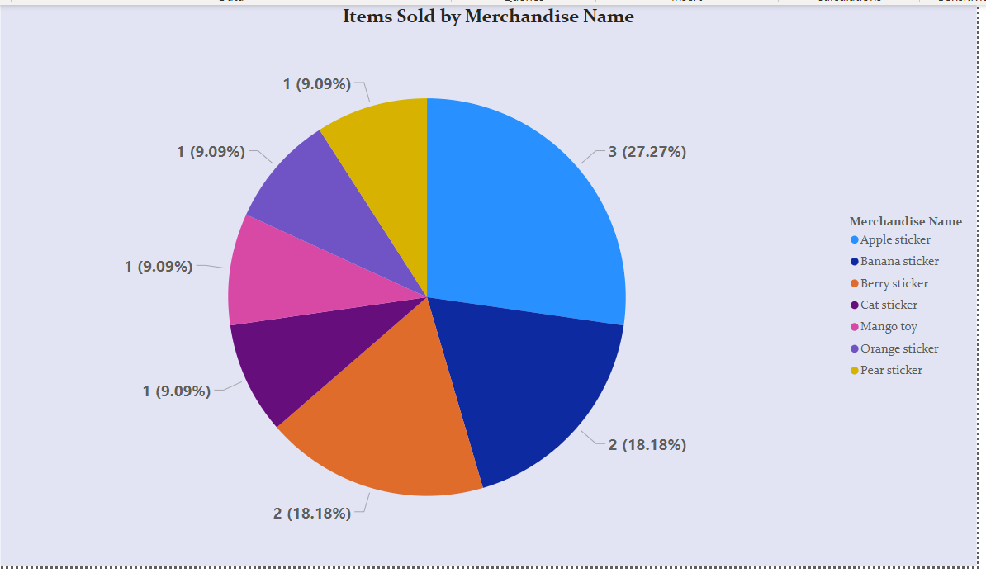
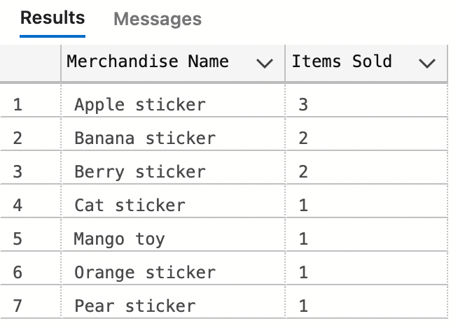
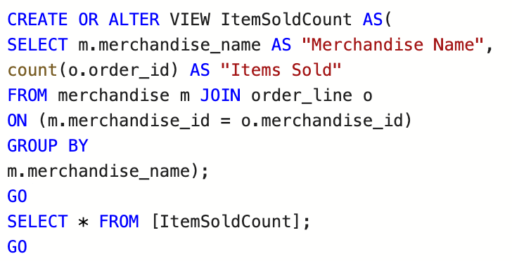
Views and Data Visualization
The most popular: Apple Sticker

Slide 12

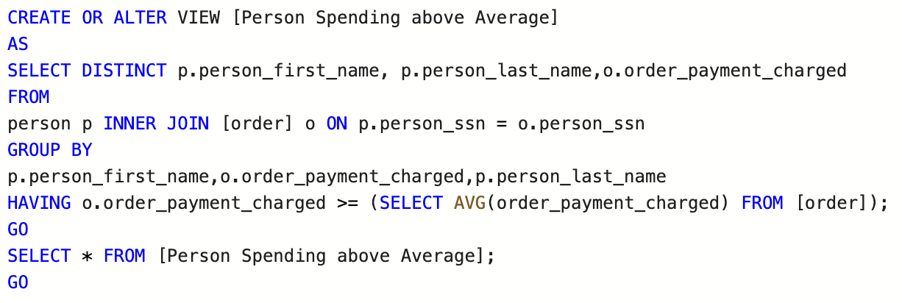
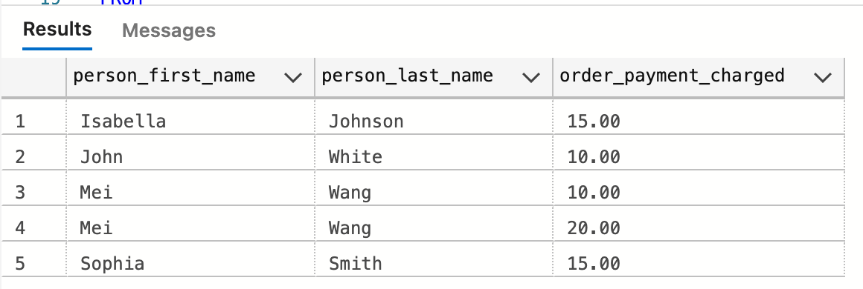
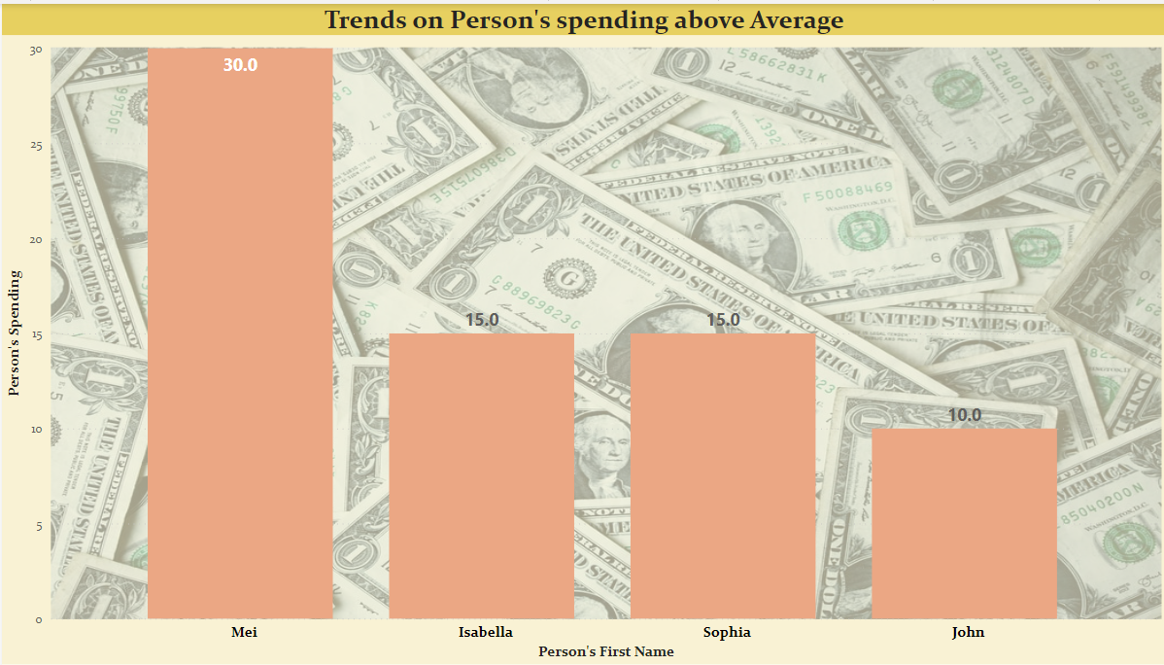
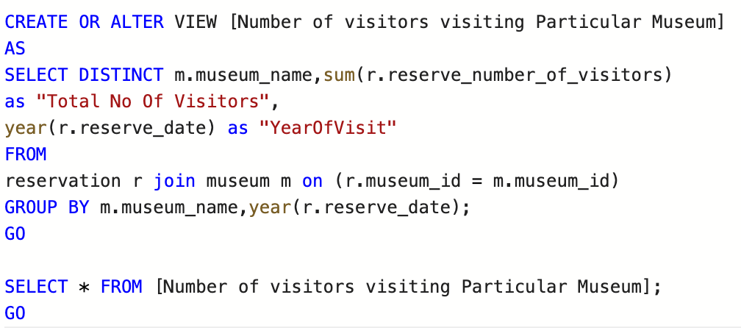
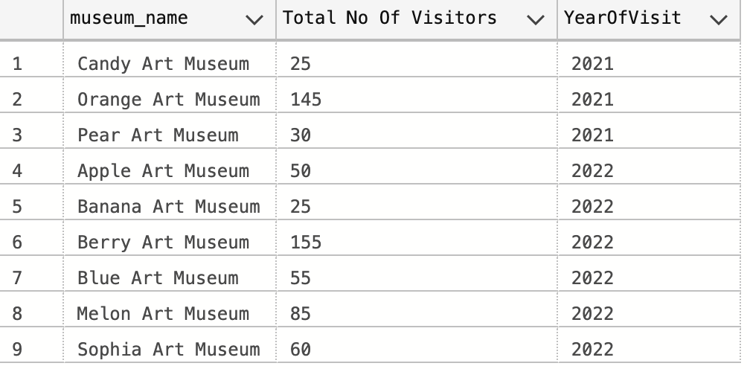
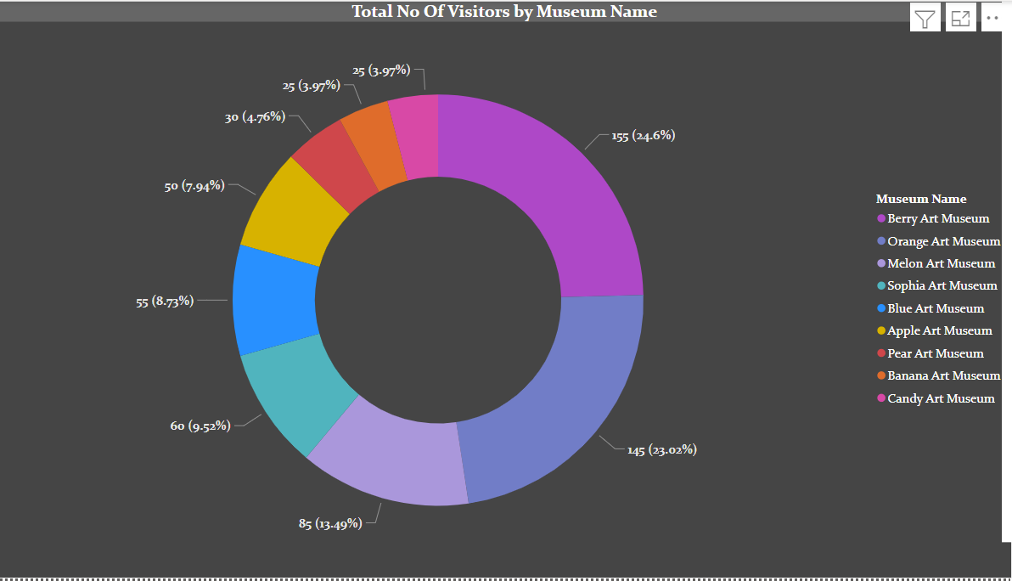
Views and Data Visualization
Mei purchased the most on merchandise, much higher than others
The most popular museum: Berry Art Museum
Little difference between Berry and Orange

Slide 13
Thanks for listening!

